Slide 1
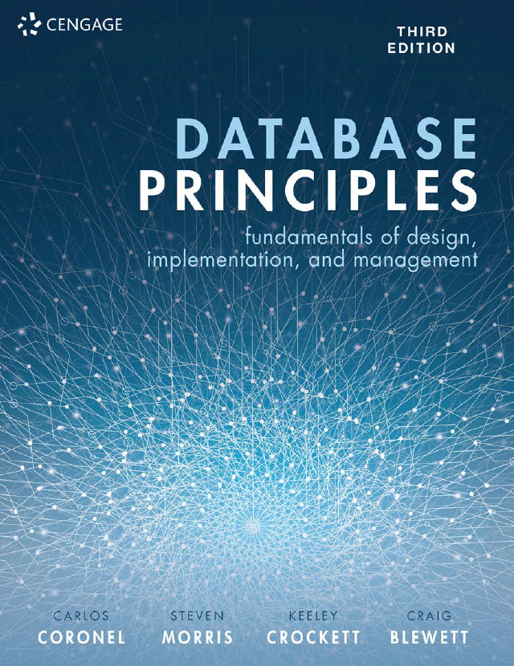
Database Principles Fundamentals of Design, Implementation, and Management
Carlos Coronel, Steven Morris,
Keeley Crockett, Craig Blewett
CHAPTER 2
DATA MODELS

Slide 2
In this chapter, you will learn:
Why data models are important
About the basic data-modeling building blocks
What business rules are and how they influence database design
How the major data models evolved
How data models can be classified by level of abstraction

Slide 3
The Importance of Data Models
Data models
Relatively simple representations, usually graphical, of complex real-world data structures
Facilitate interaction among the designer, the applications programmer, and the end user

Slide 4
The Importance of Data Models (continued)
End-users have different views and needs for data
Data model organises data for various users

Slide 5
Data Model Basic Building Blocks
Entity - anything about which data are to be collected and stored
Attribute - a characteristic of an entity
Relationship - describes an association among entities
One-to-many (1:*) relationship
Many-to-many (*:*) relationship
One-to-one (1:1) relationship
Constraint - a restriction placed on the data

Slide 6
Business Rules
Brief, precise, and unambiguous descriptions of a policies, procedures, or principles within a specific organisation
Apply to any organisation that stores and uses data to generate information
Description of operations that help to create and enforce actions within that organisation’s environment

Slide 7
Business Rules (continued)
Must be rendered in writing
Must be kept up to date
Sometimes are external to the organisation
Must be easy to understand and widely disseminated
Describe characteristics of the data as viewed by the company

Slide 8
Discovering Business Rules
Sources of Business Rules:
Company managers
Policy makers
Department managers
Written documentation
Procedures
Standards
Operations manuals
Direct interviews with end users

Slide 9
Translating Business Rules into Data Model Components
Standardise company’s view of data
Constitute a communications tool between users and designers
Allow designer to understand the nature, role, and scope of data
Allow designer to understand business processes
Allow designer to develop appropriate relationship participation rules and constraints
Promote creation of an accurate data model

Slide 10
Discovering Business Rules (continued)
Generally, nouns translate into entities
Verbs translate into relationships among entities
Relationships are bi-directional

Slide 11
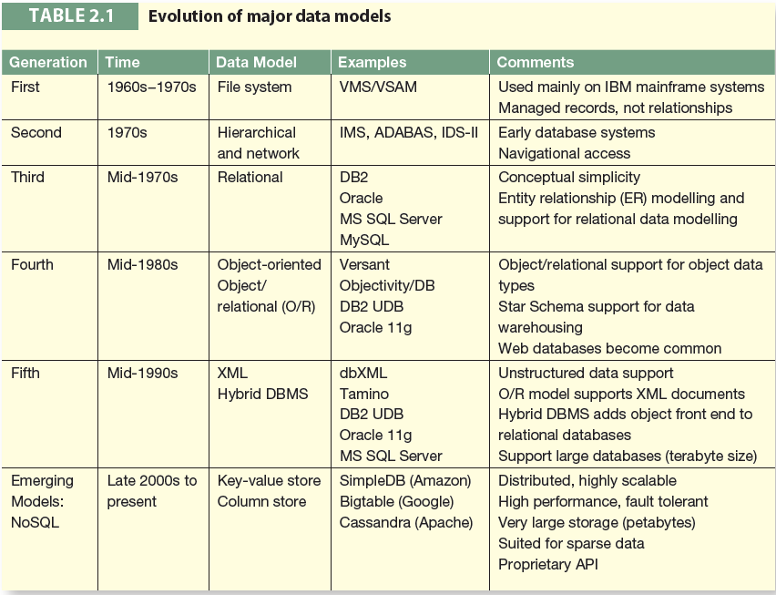
The Evolution of Data Models

Slide 12
The Evolution of Data Models (continued)
Hierarchical and Network
Relational
Object oriented (OO) and Object Relational O/R)
XML Hybrid Databases
Key-value store and Column Store

Slide 13
The Hierarchical Model
Developed in the 1960s to manage large amounts of data for complex manufacturing projects
Basic logical structure is represented by an upside-down “tree”

Slide 14
The Hierarchical Model (continued)
The hierarchical structure contains levels, or segments
Depicts a set of one-to-many (1:*) relationships between a parent and its children segments
Each parent can have many children
each child has only one parent

Slide 15
The Hierarchical Model (continued)
Advantages
Many of the hierarchical data model’s features formed the foundation for current data models
Its database application advantages are replicated, albeit in a different form, in current database environments
Generated a large installed (mainframe) base, created a pool of programmers who developed numerous tried-and-true business applications

Slide 16
The Hierarchical Model (continued)
Disadvantages
Complex to implement
Difficult to manage
Lacks structural independence
Implementation limitations
Lack of standards

Slide 17
The Network Model
Created to
Represent complex data relationships more effectively
Improve database performance
Impose a database standard

Slide 18
The Network Model (continued)
Schema
Conceptual organisation of entire database as viewed by the database administrator
Subschema
Defines database portion “seen” by the application programs that actually produce the desired information from data contained within the database
Data Management Language (DML)
Defines the environment in which data can be managed

Slide 19
The Network Model (continued)
Schema Data Definition Language (DDL)
Enables database administrator to define schema components
Subschema DDL
Allows application programs to define database components that will be used
DML
Works with the data in the database

Slide 20
The Network Model (continued)
Resembles hierarchical model
Collection of records in 1:* relationships
Set
Relationship
Composed of at least two record types
Owner
Equivalent to the hierarchical model’s parent
Member
Equivalent to the hierarchical model’s child

Slide 21
The Network Model (continued)
Disadvantages
Too cumbersome
The lack of ad hoc query capability put heavy pressure on programmers
Any structural change in the database could produce havoc in all application programs that drew data from the database
Many database old-timers can recall the interminable information delays

Slide 22
The Relational Model
Developed by Codd (IBM) in 1970
Considered ingenious but impractical in 1970
Conceptually simple
Computers lacked power to implement the relational model
Today, microcomputers can run sophisticated relational database software

Slide 23
The Relational Model (continued)
Relational Database Management System (RDBMS)
Performs same basic functions provided by hierarchical and network DBMS systems, in addition to a host of other functions
Most important advantage of the RDBMS is its ability to hide the complexities of the relational model from the user

Slide 24
The Relational Model (continued)
Table (relations)
Matrix consisting of a series of row/column intersections
Related to each other through sharing a common entity characteristic
Relational diagram
Representation of relational database’s entities, attributes within those entities, and relationships between those entities

Slide 25
The Relational Model (continued)
Relational Table
Stores a collection of related entities
Resembles a file
Relational table is purely logical structure
How data are physically stored in the database is of no concern to the user or the designer
This property became the source of a real database revolution

Slide 26
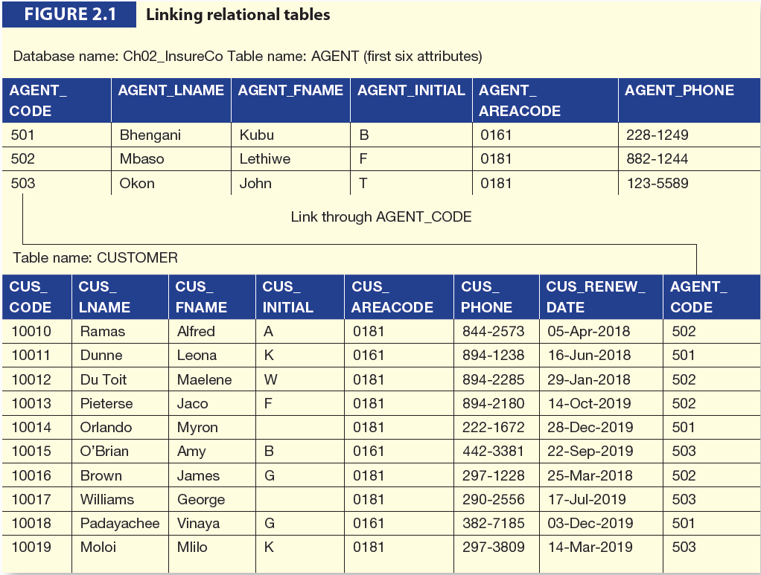
The Relational Model (continued)

Slide 27
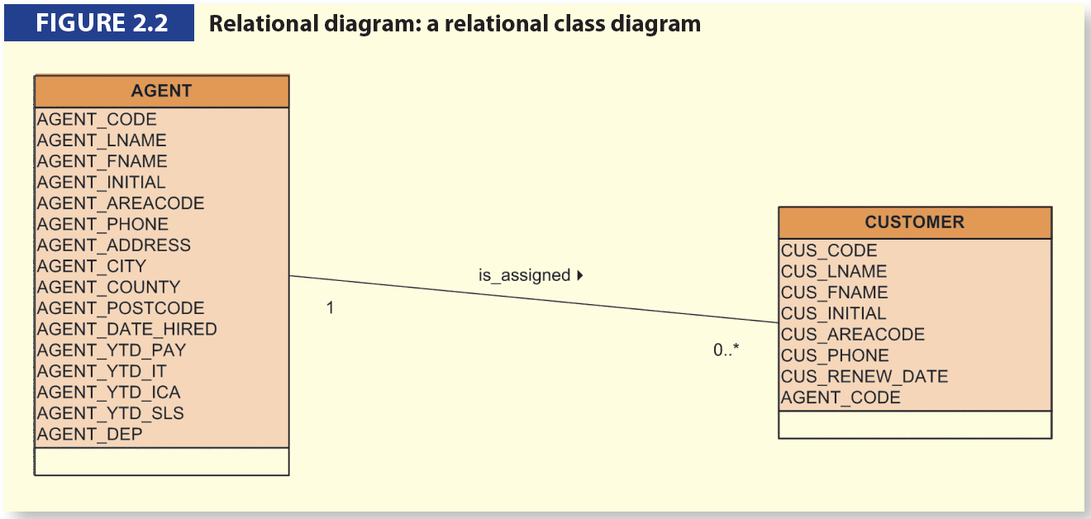
The Relational Model (continued)

Slide 28
The Relational Model (continued)
Rise to dominance due in part to its powerful and flexible query language
Structured Query Language (SQL) allows the user to specify what must be done without specifying how it must be done
SQL-based relational database application involves:
User interface
A set of tables stored in the database
SQL engine

Slide 29
The Entity Relationship Model
Widely accepted and adapted graphical tool for data modeling
Introduced by Chen in 1976
Graphical representation of entities and their relationships in a database structure.
More recently the class diagram component of the Unified Modeling Language (UML) has been used to produce entity relationship models.

Slide 30
The Entity Relationship Model (continued)
Entity relationship diagram (ERD)
Uses graphic representations to model database components
Entity is mapped to a relational table
Entity instance (or occurrence) is row in table
Entity set is collection of like entities
Connectivity labels types of relationships

Slide 31
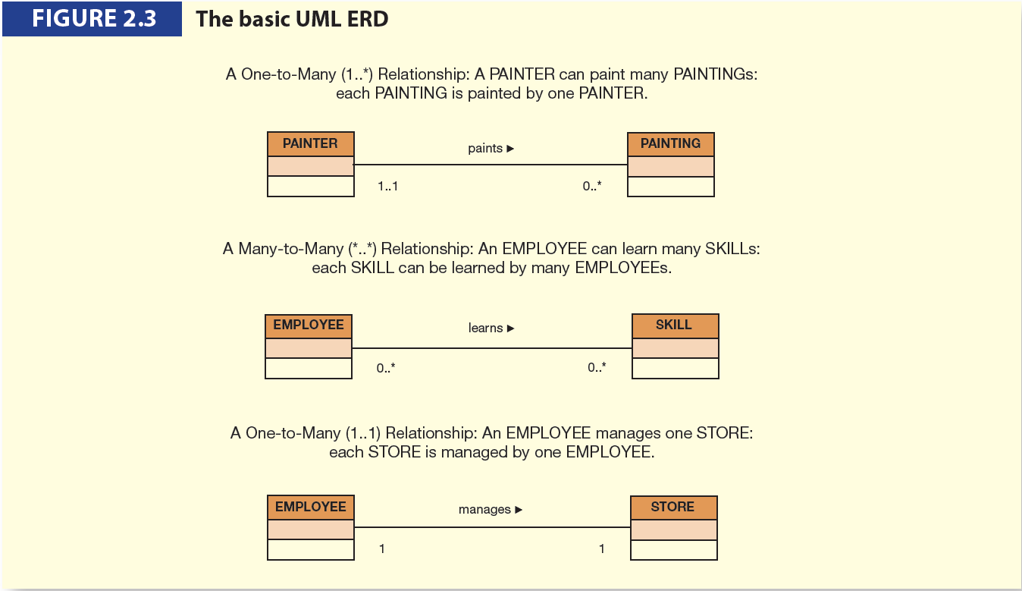
The Entity Relationship Model The basic UML ERD

Slide 32
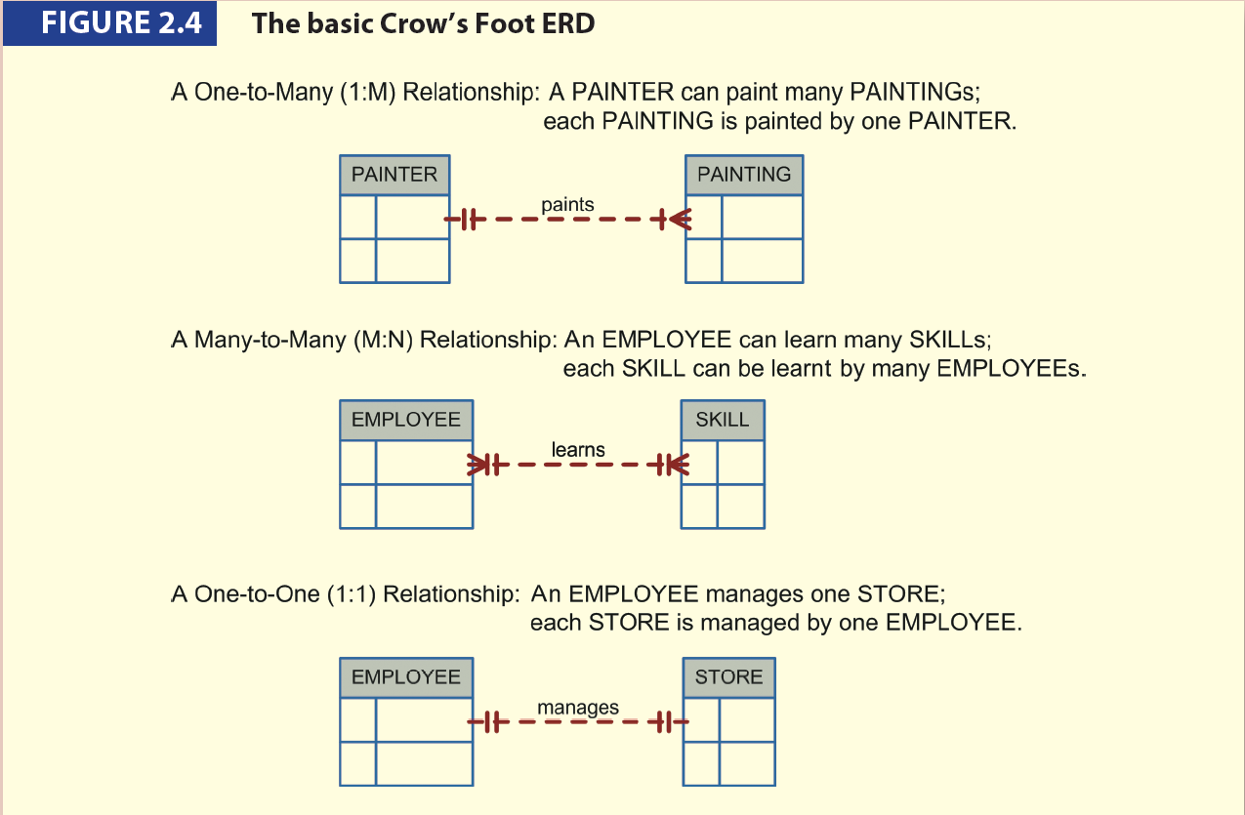
The Entity Relationship Model (continued)

Slide 33
The Object Oriented Model
Modeled both data and their relationships in a single structure known as an object
Object-oriented data model (OODM) is the basis for the object-oriented database management system (OODBMS)
OODM is said to be a semantic data model

Slide 34
The Object Oriented Model (continued)
Object described by its factual content
Like relational model’s entity
Includes information about relationships between facts within object, and relationships with other objects
Unlike relational model’s entity
Subsequent OODM development allowed an object to also contain all operations
Object becomes basic building block for autonomous structures

Slide 35
The Object Oriented Model (continued)
Object is an abstraction of a real-world entity
Attributes describe the properties of an object
Objects that share similar characteristics are grouped in classes
Classes are organised in a class hierarchy
Inheritance is the ability of an object within the class hierarchy to inherit the attributes and methods of classes above it

Slide 36
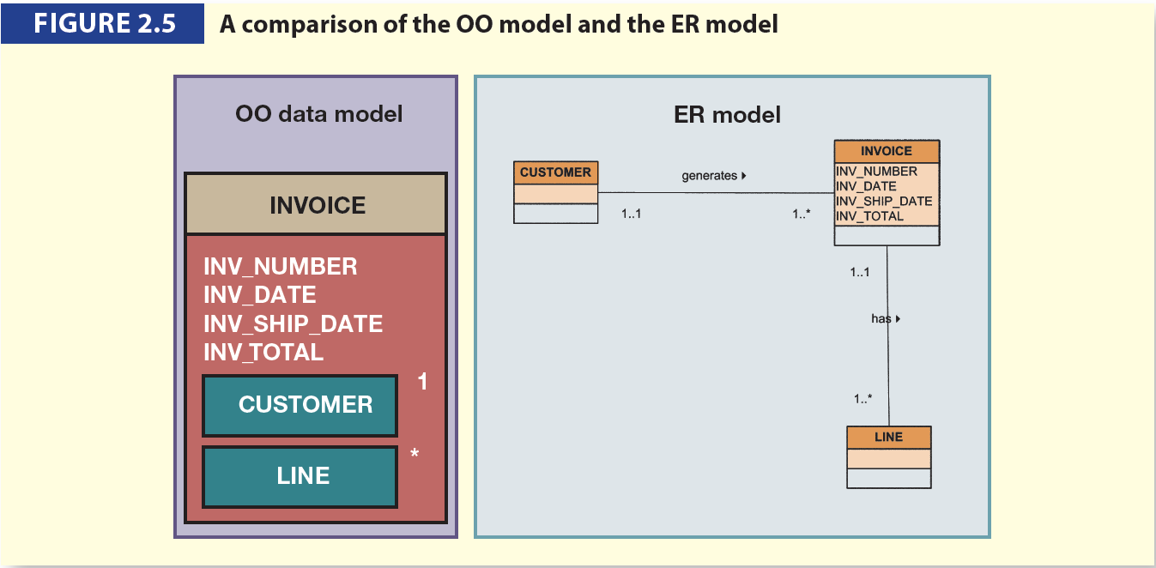
The Object Oriented Model (continued)

Slide 37
Other Models
Extended Relational Data Model (ERDM)
Semantic data model developed in response to increasing complexity of applications
DBMS based on the ERDM often described as an object/relational database management system (ORDBMS)
Primarily geared to business applications

Slide 38
Data Models: A Summary
Each new data model capitalised on the shortcomings of previous models
Common characteristics:
Conceptual simplicity without compromising the semantic completeness of the database
Represent the real world as closely as possible
Representation of real-world transformations (behaviour) must comply with consistency and integrity characteristics of any data model

Slide 39
Emerging Data Models: Big Data and NoSQL
Big Data refers to a movement to find new and better ways to manage large amounts of Web-generated data and derive business insight from it, while simultaneously providing high performance and scalability at a reasonable cost.

Slide 40
Emerging Data Models: Big Data and NoSQL (continued)
The relational approach does not always match the needs of organisations with Big Data challenges.
It is not always possible to fi t unstructured, social media data into the conventional relational structure of rows and columns.
Adding millions of rows of multi-format (structured and nonstructured) data on a daily basis will
inevitably lead to the need for more storage, processing power, and sophisticated data analysis
tools that may not be available in the relational environment.
The type of high-volume implementations required in the RDBMS environment
for the Big Data problem comes with a hefty price tag for expanding hardware, storage, and software licenses.
Data analysis based on OLAP tools has proven to be very successful in relational environments with highly structured data.

Slide 41
NoSQL Databases
NoSQL to refer to a new generation of databases that address the specific challenges of the Big Data era.
They have the following general characteristics:
Not based on the relational model, hence the name NoSQL.
Supports distributed database architectures.
Provides high scalability, high availability, and fault tolerance.
Supports very large amounts of sparse data.
Geared toward performance rather than transaction consistency.

Slide 42
NoSQL Databases (continued)
The key-value data model is based on a structure composed of two data elements: a key and a value, in which every key has a corresponding value or set of values.
The key-value data model is also referred to as the attribute-value or associative data model.

Slide 43
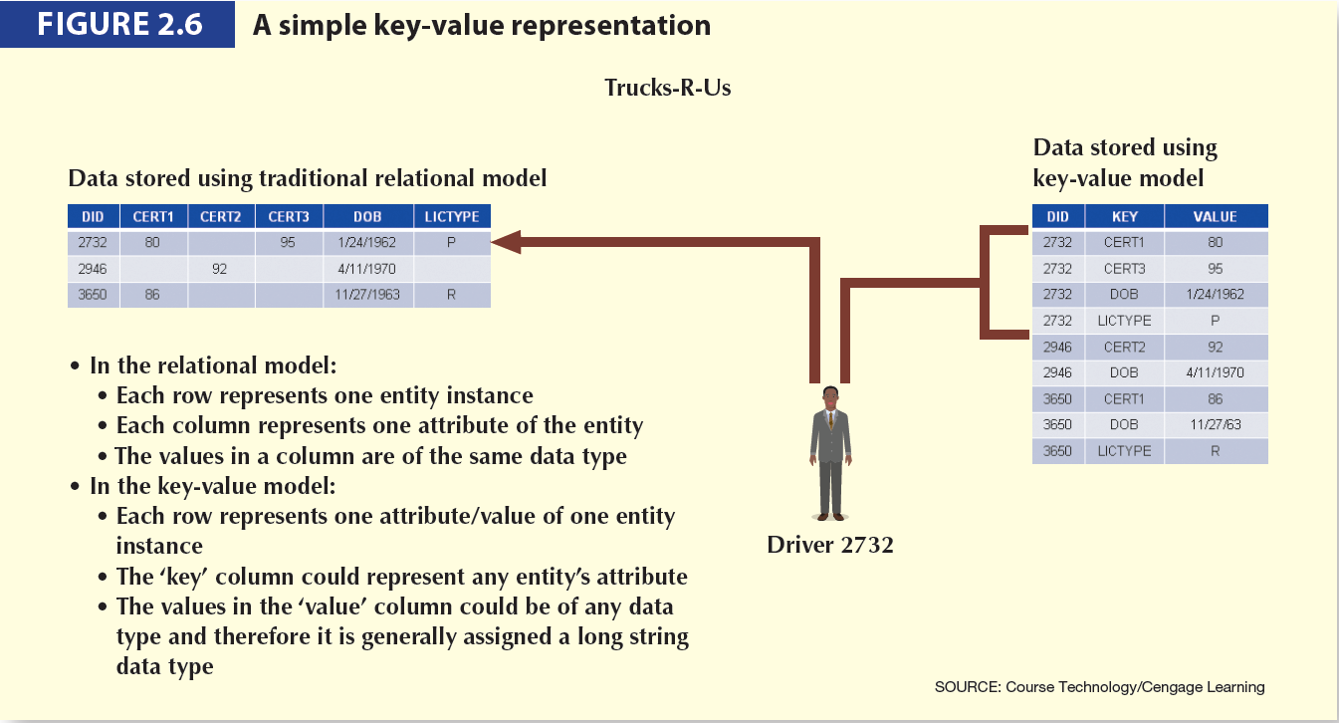
NoSQL Databases (continued)

Slide 44
NoSQL Databases (continued)
The data type of the “value” column is generally a long string to accommodate the variety of actual data types of the values placed in the column.
To add a new entity attribute in the relational model, you need to modify the table definition.
To add a new attribute in the key-value store, you add a row to the key-value store, which is why it is said to be “schema-less.”
NoSQL databases do not store or enforce relationships among entities.

Slide 45
NoSQL Databases (continued)
NoSQL databases use their own native application programming interface (API) with simple data access commands, such as put, read, and delete.
Indexing and searches can be difficult. Because the “value” column in the key-value data model could contain many different data types, it is often difficult to create indexes on the data. At the same time, searches can become very complex.

Slide 46
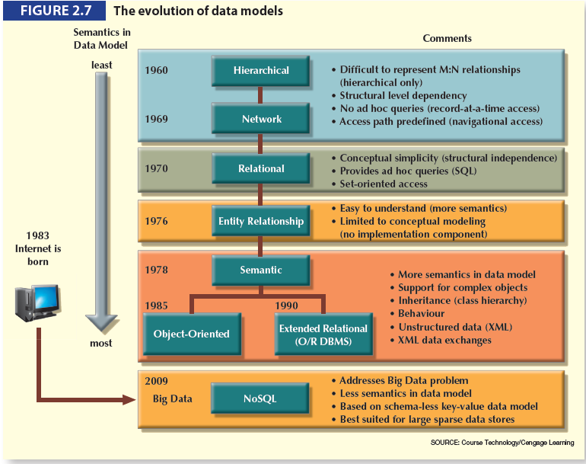
Data Models: A Summary (continued)

Slide 47
Degrees of Data Abstraction
Way of classifying data models
Many processes begin at high level of abstraction and proceed to an ever-increasing level of detail
Designing a usable database follows the same basic process

Slide 48
Degrees of Data Abstraction (continued)
American National Standards Institute (ANSI) Standards Planning and Requirements Committee (SPARC)
Defined a framework for data modeling based on degrees of data abstraction(1970s):
External
Conceptual
Internal

Slide 49
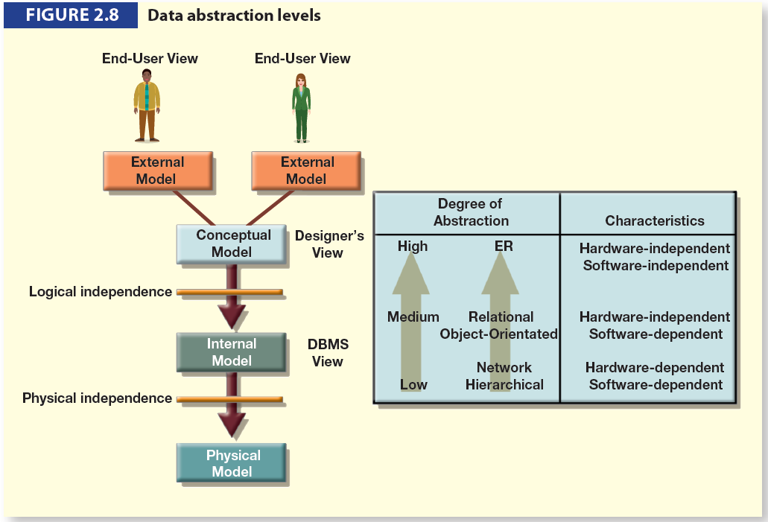
Degrees of Data Abstraction (continued)

Slide 50
The External Model
End users’ view of the data environment
Requires that the modeler subdivide set of requirements and constraints into functional modules that can be examined within the framework of their external models

Slide 51
The External Model (continued)
Advantages:
Easy to identify specific data required to support each business unit’s operations
Facilitates designer’s job by providing feedback about the model’s adequacy
Creation of external models helps to ensure security constraints in the database design
Simplifies application program development

Slide 52
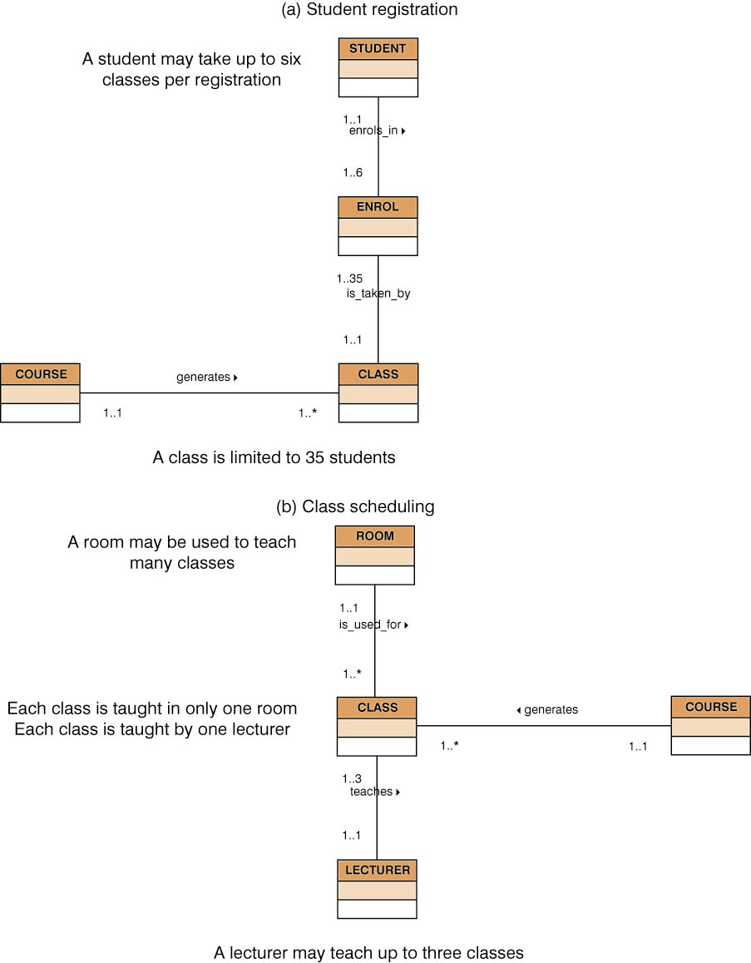
The External Model (continued)
Fig 2.9 External Models for Tiny College

Slide 53
The External Model (continued)
Fig 2.9 External Models for Tiny College

Slide 54
The Conceptual Model
Represents global view of the entire database
Representation of data as viewed by the entire organisation
Basis for identification and high-level description of main data objects, avoiding details
Most widely used conceptual model is the entity relationship (ER) model

Slide 55
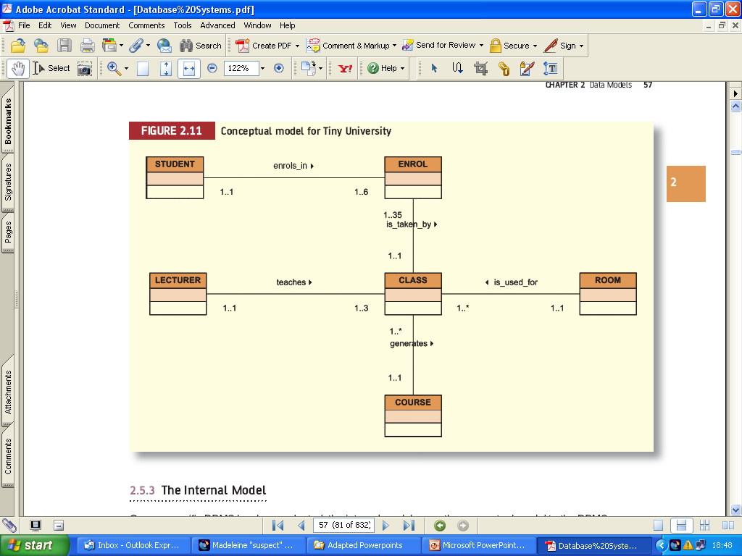
The Conceptual Model (continued)
Fig 2.10 The Conceptual Model for Tiny College

Slide 56
The Conceptual Model (continued)
Provides a relatively easily understood macro level view of data environment
Independent of both software and hardware
Does not depend on the DBMS software used to implement the model
Does not depend on the hardware used in the implementation of the model
Changes in either hardware or DBMS software have no effect on the database design at the conceptual level

Slide 57
The Internal Model
Representation of the database as “seen” by the DBMS
Maps the conceptual model to the DBMS
Internal schema depicts a specific representation of an internal model

Slide 58
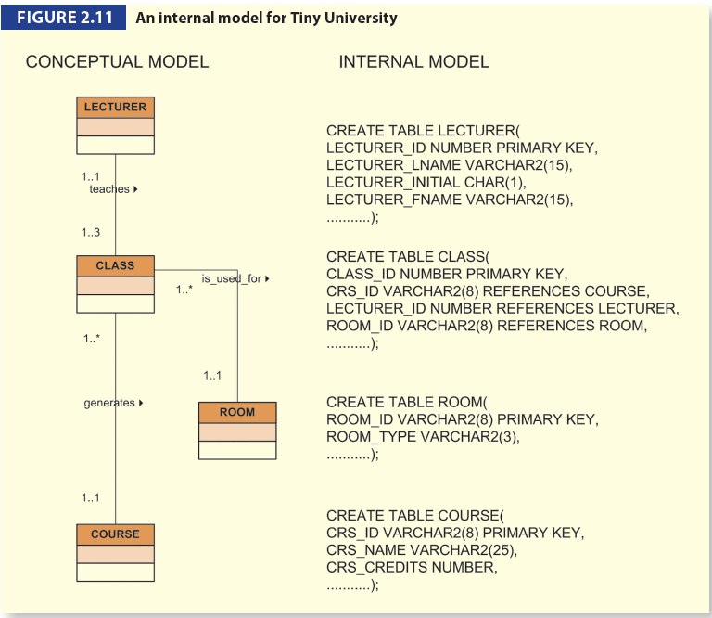
An Internal Model for Tiny University

Slide 59
The Physical Model
Operates at lowest level of abstraction, describing the way data are saved on storage media such as disks or tapes
Software and hardware dependent
Requires that database designers have a detailed knowledge of the hardware and software used to implement database design

Slide 60
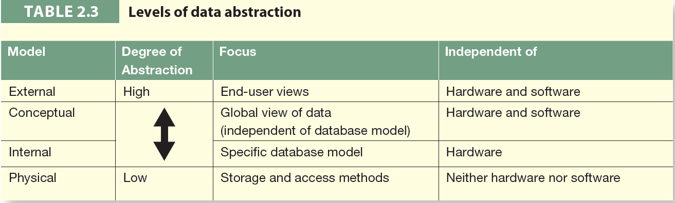
The Physical Model (continued)

Slide 61
Summary
A data model is a (relatively) simple abstraction of a complex real-world data environment
Basic data modeling components are:
Entities
Attributes
Relationships
Constraints

Slide 62
Summary (continued)
Hierarchical model
Depicts a set of one-to-many (1:*) relationships between a parent and its children segments
Network data model
Uses sets to represent 1:* relationships between record types
Relational model
Current database implementation standard
ER model is a popular graphical tool for data modeling that complements the relational model

Slide 63
Summary (continued)
Object is basic modeling structure of object oriented data model
The relational model has adopted many object-oriented extensions to become the extended relational data model (ERDM)
Data modeling requirements are a function of different data views (global vs. local) and level of data abstraction
NoSQL databases are a new generation of databases that do not use the relational model and are geared to support the very specific needs of Big Data organisations

